Slide 1
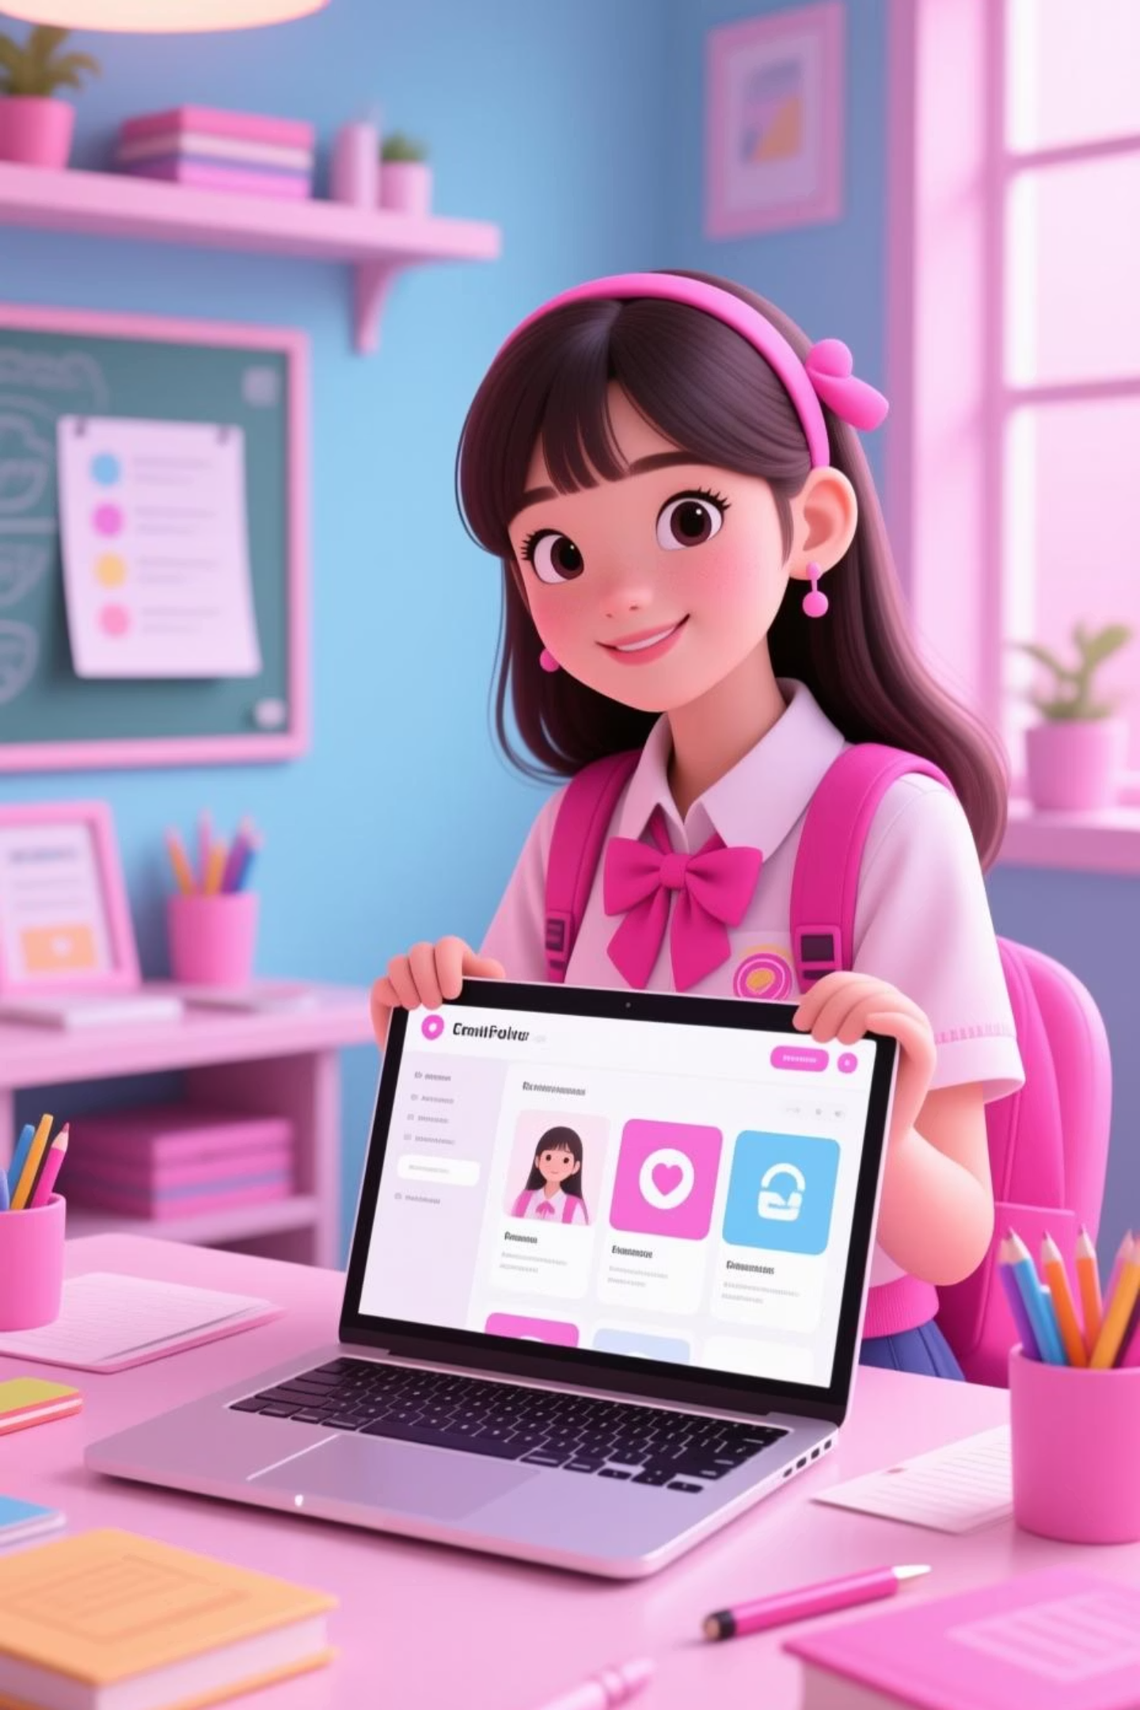
Student Digital Portfolio
Presented by V.Tamilselvi
Register No & NMID: 24131021802522052
Department: B.Sc. Computer Science
College: C.Kandaswami Naidu College for Women

Slide 2
Showcasing Academic and Professional Excellence
Project Title: Developing an Interactive Digital Portfolio for Enhanced Student Visibility and Career Readiness
This project aims to create a dynamic and easily accessible platform for students to present their academic achievements, projects, and skills to potential employers and educational institutions.

Slide 3
Presentation Roadmap
1
Problem Statement
Identifying the challenges in traditional student showcasing.
2
Project Overview
A concise look at what this digital portfolio entails.
3
End Users
Understanding who benefits most from this platform.
4
Tools and Technologies
The essential components used in its development.
5
Portfolio Design and Layout
The aesthetic and structural considerations.
6
Features and Functionality
Key capabilities that make it stand out.
7
Results and Screenshots
Visual evidence of the portfolio in action.
8
Conclusion
Summarising the project's impact and future.
9
GitHub Link
Accessing the project's source code and documentation.

Slide 4
The Challenge: Bridging the Gap
Traditional CVs Lack Depth
Limited Visibility
Static resumes often fail to capture the full scope of a student's practical skills, project work, and creative abilities. They provide a limited view, making it hard for employers to assess true potential.
Students struggle to showcase their hands-on experience in a compelling and accessible format. This hinders their ability to stand out in a competitive job market or gain admission to advanced academic programmes.
This project addresses these limitations by providing a dynamic, interactive, and visually engaging platform for students to present their holistic profile.

Slide 5
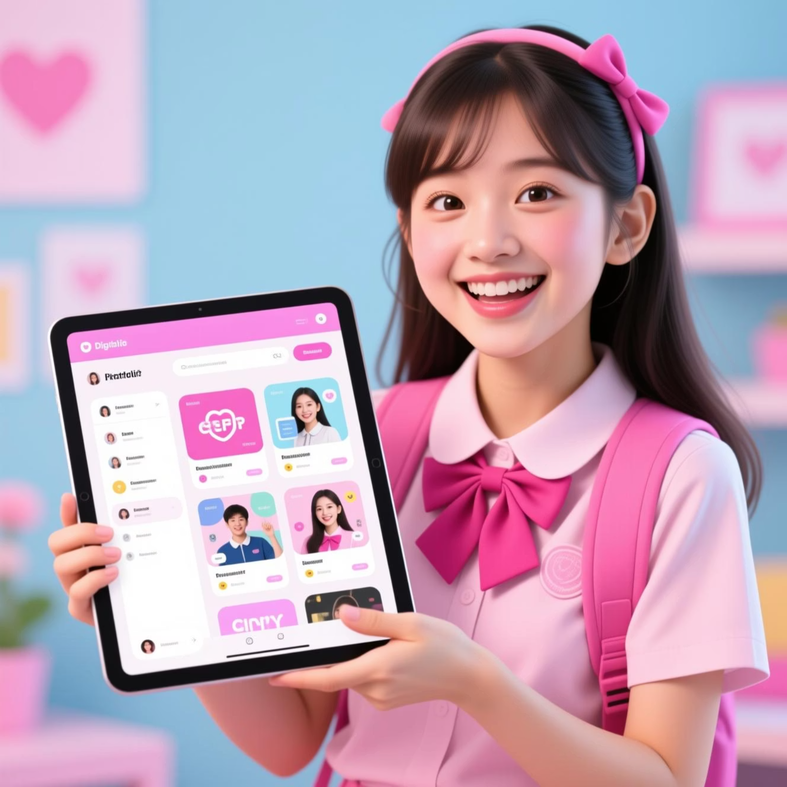
Project Overview: Your Digital Gateway
The Digital Portfolio is a personal online platform designed for students to effectively exhibit their academic projects, technical skills, certifications, and extracurricular achievements.
It serves as a comprehensive, living document that evolves with the student's growth, offering an interactive experience for viewers compared to a traditional, static curriculum vitae.
It's built with responsiveness in mind, ensuring a seamless viewing experience across all devices, from desktops to mobile phones.

Slide 6



Who Benefits from This Portfolio?
Students
Employers & Recruiters
Academic Institutions
Empowering them to present their abilities beyond grades and traditional resumes, boosting confidence and visibility.
Providing a richer, more detailed insight into a candidate's practical skills, project experience, and problem-solving capabilities.
Enabling admissions committees to better evaluate prospective students for higher education programmes based on tangible work.

Slide 7

Foundational Tools & Technologies
Front-end: HTML5 for structure, CSS3 for styling, and JavaScript for interactivity.
Frameworks: Bootstrap for responsive design and streamlined development.
Version Control: Git and GitHub for collaborative development and project management.
Design Tools: Basic image editing software for optimising visuals.
Editor: Visual Studio Code for efficient coding.
These technologies ensure the portfolio is robust, user-friendly, and visually appealing across various platforms.

Slide 8

Intuitive Design & Structured Layout
Clean Aesthetics
User-Centric Navigation
Minimalist design with ample white space for readability, allowing content to take centre stage.
Clear, intuitive menu system for easy exploration of different sections (About, Projects, Skills, Contact).
Responsive Adaptability
Thematic Consistency
Fluid layout ensures optimal viewing on desktops, tablets, and mobile devices.
A unified colour palette and typography maintain a professional and cohesive brand identity.

Slide 9
Key Features & Functionality
Dynamic Project Showcase
Skills Matrix
Downloadable CV
Visual representation of proficiency levels in various programming languages, software, and soft skills.
Option to download a traditional PDF version of the resume for quick reference.
Dedicated sections for detailed project descriptions, including images, videos, and live demos where applicable.
Contact Form
Blog/Updates Section
Integrated form for direct communication and inquiries from interested parties.
Optional area for personal reflections, new learnings, or project updates, showcasing continuous growth.

Slide 10
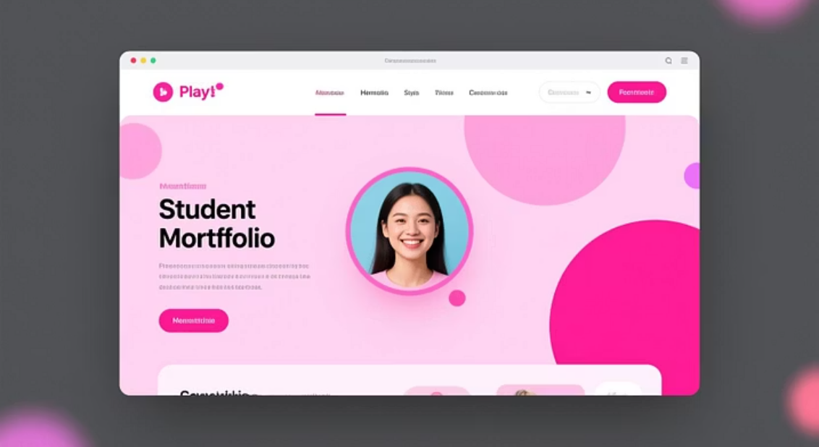
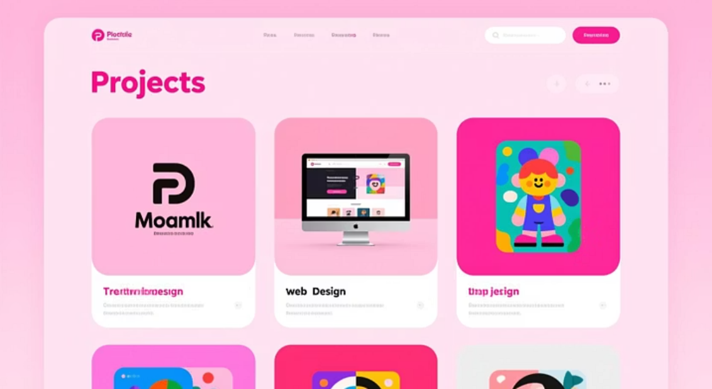
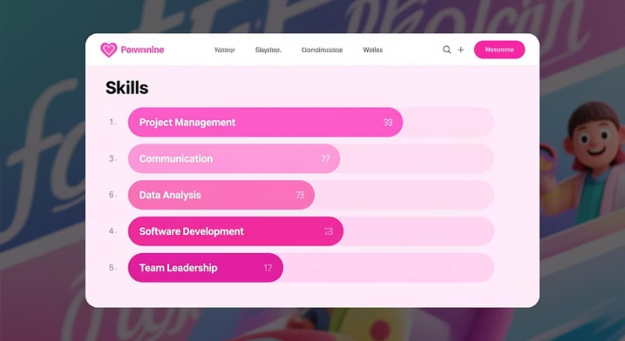

Results & Visual Snapshot
The developed digital portfolio provides a modern, intuitive, and effective platform for students to present their capabilities.
It serves as a professional online presence, enhancing visibility and facilitating career and academic opportunities.

